Slide 1
Online Store Application
System Development Project
By Liam Corcoran, Lucas Magnien, Nirosh Ratnam, and Yu-Tang Yu

Slide 2
Project Definition
online store application cloud SAAS providing online POS for customers of client businesses,
collation of shopping information for business statistical analysis,
creation of financial statements based on collated information.
provide exposure and feedback for business startups with new business identities and products as quickly and easily as possible, within a community setting.

Slide 3
Risk Assessment
Personnel
Group members may leave the group or fall into a condition where they are not able to reach deadlines
Technology
Tools or strategies may fail due to unforeseen circumstances
Scope
The amount of work required for deadline may be beyond our abilities to accomplish in this term

Slide 4
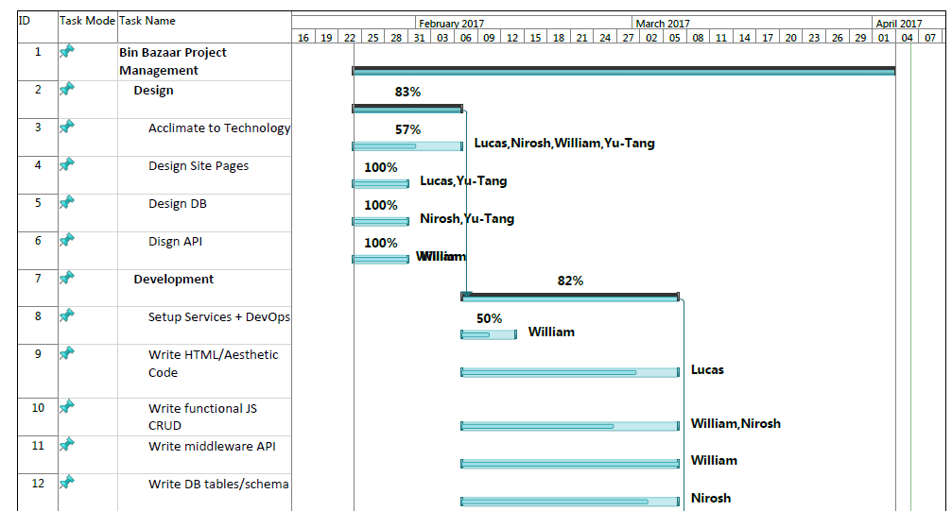
Task Breakdown – Gantt Chart

Slide 5
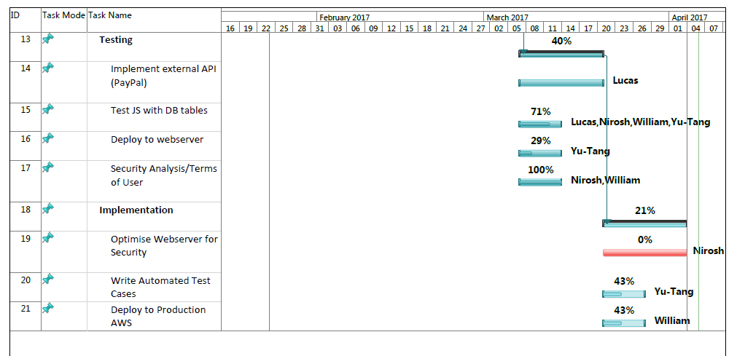
Task Breakdown – Gantt Chart

Slide 6
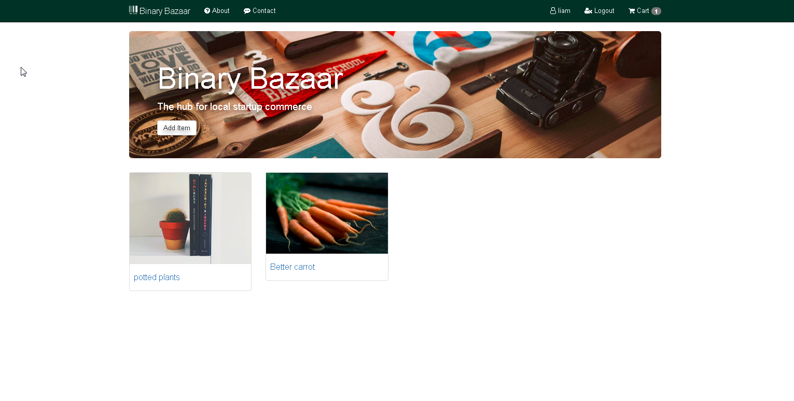

Slide 7
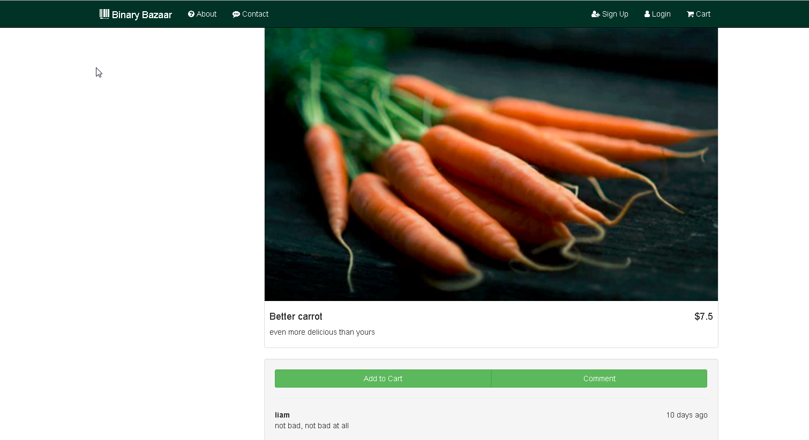

Slide 8
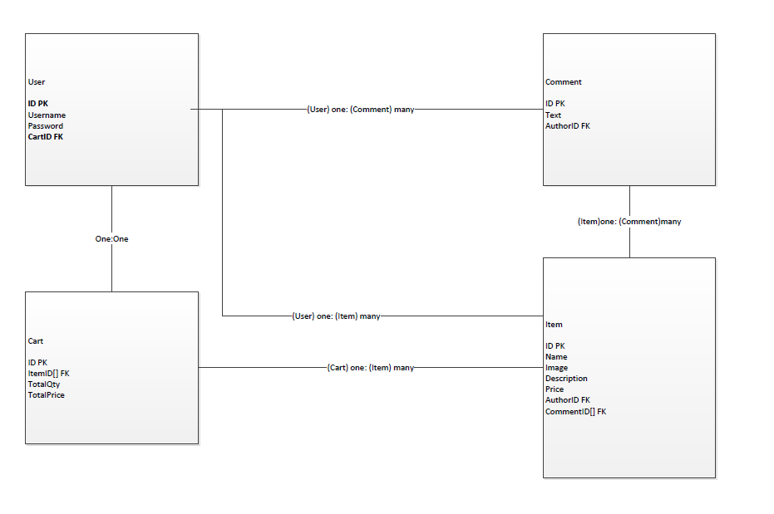
Database Design

Slide 9
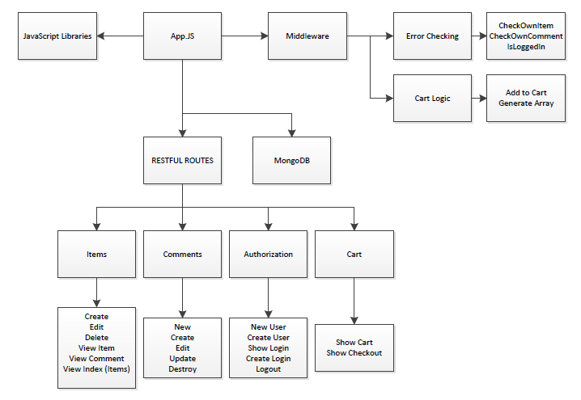
ER

Slide 10
Link to demo
https://webdev-corvos.c9users.io/

Slide 11
Risk Compensation
Personnel
Modular phase strategy allows for task load balancing between group members
Technology
The creation of features is scheduled on an as-needed basis, meaning that the most important work is completed first and refining will occur afterwards
This allows us to find out what works early enough to still have time to change strategy or technology
Scope
Creating features in parallel will allow coaching within the team, which may help with the abilities that fall short within the group

Slide 12
Issues
Personnel
Learning pace differed from person to person, the completion tolerance was in fact supplemented by those who were faster, but this caused us to make time sacrifices that would delay completion
Technology
Technology choices changed from initial design to final project
(example instead of using Kong API we used express framework for Node.js)
Underestimated time required to setup Amazon Web Services
Scope
Attempting to create a fully functional user-driven marketplace was a “moon shot” but in retrospective we accomplished a lot considering we were learning while applying new concepts.

Slide 13
Conclusion
What we learned about management
Modular development is highly dependant on the development team
Training importance should be highest priority so completion doesn’t stagger
Dedicated roles based on technology may have been useful to supplement the team (2 modular devs, 2 dedicated infrastructure devs)
What we learned about technology
How to make a dynamic website using Node.js, Express, MongoDB
Restful Routing practices
What we learned about design
The advantages of selecting technologies that allow for scalability is a must for “Agile” as-needed feature design

